Slide 1
Introduction to Concur Premier on line expense system
World Class Tape Solutions

Slide 2
Objectives of introduction
Log on to system for the first time
Complete your profile information
Submit an expense claim
Authorise an expense claim
Request a cash advance
World Class Tape Solutions

Slide 3
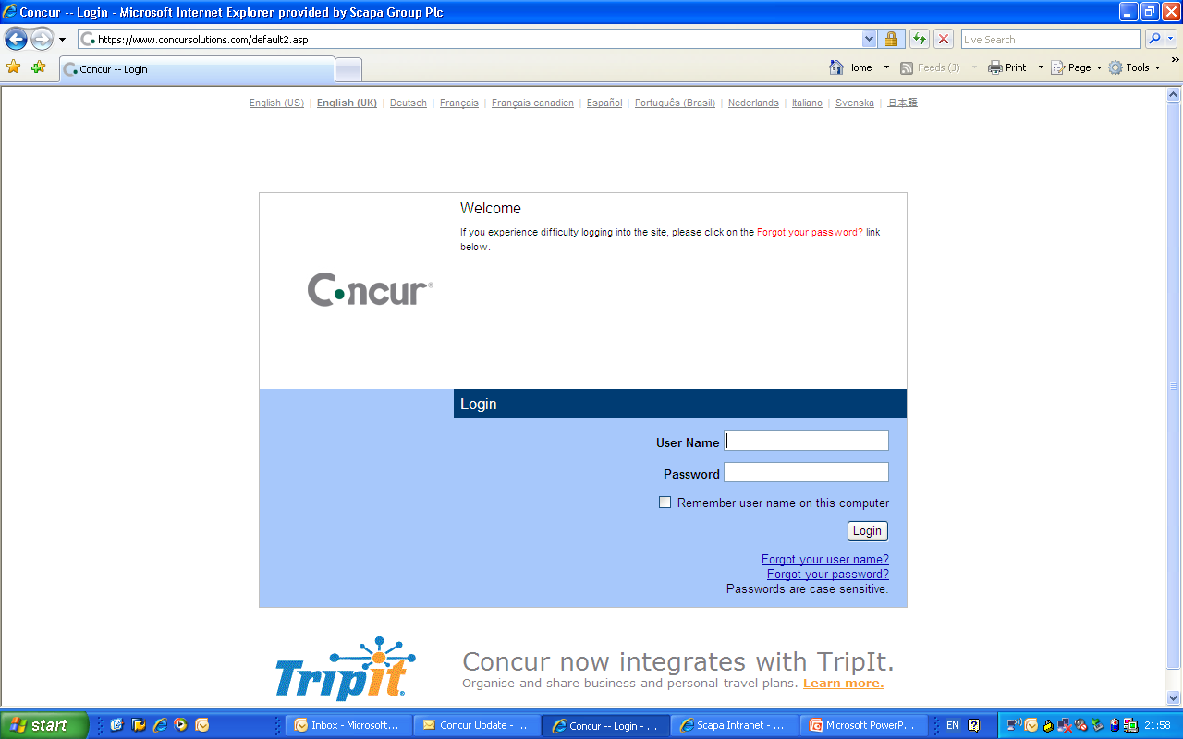
Logging on
World Class Tape Solutions

Slide 4
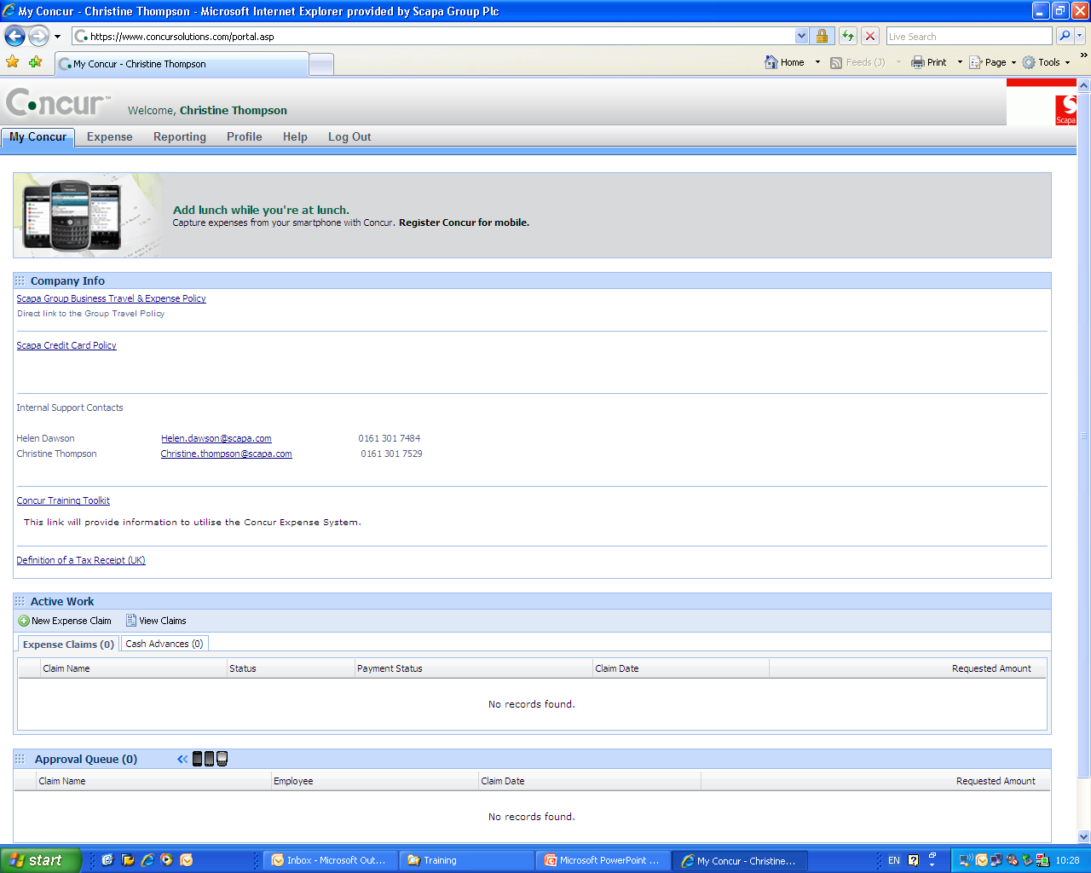
Concur Home page
World Class Tape Solutions

Slide 5
Your profile
Bank information
Expense delegates
Company or personal car details
Favourite attendees
Change password
Mobile registration
World Class Tape Solutions

Slide 6
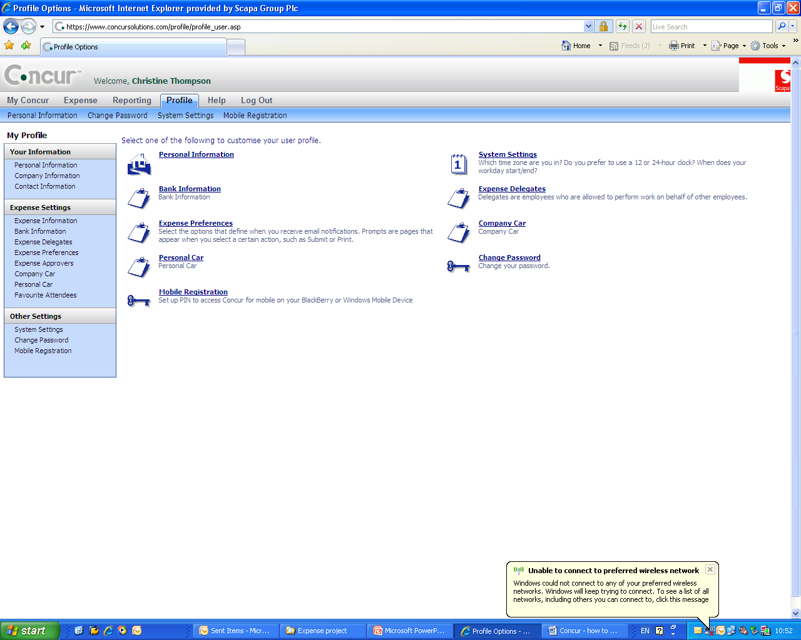
Profile
World Class Tape Solutions

Slide 7
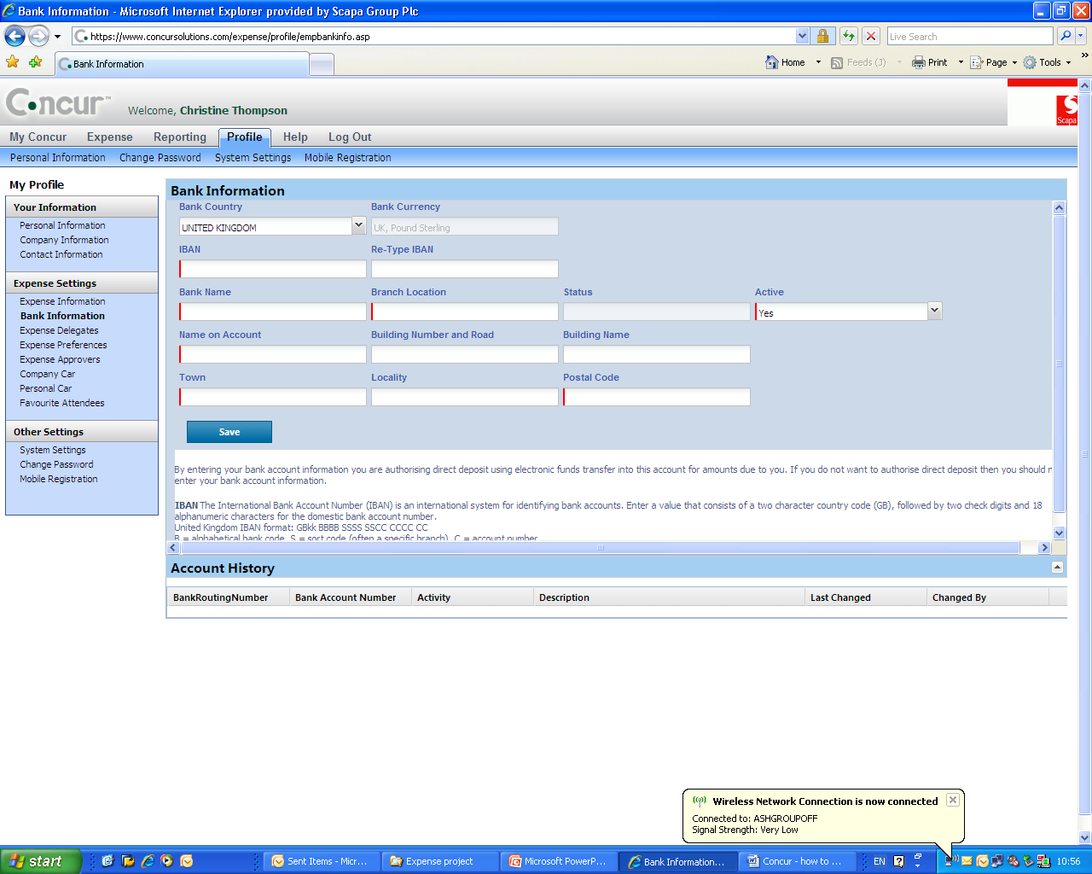
Bank information
World Class Tape Solutions

Slide 8
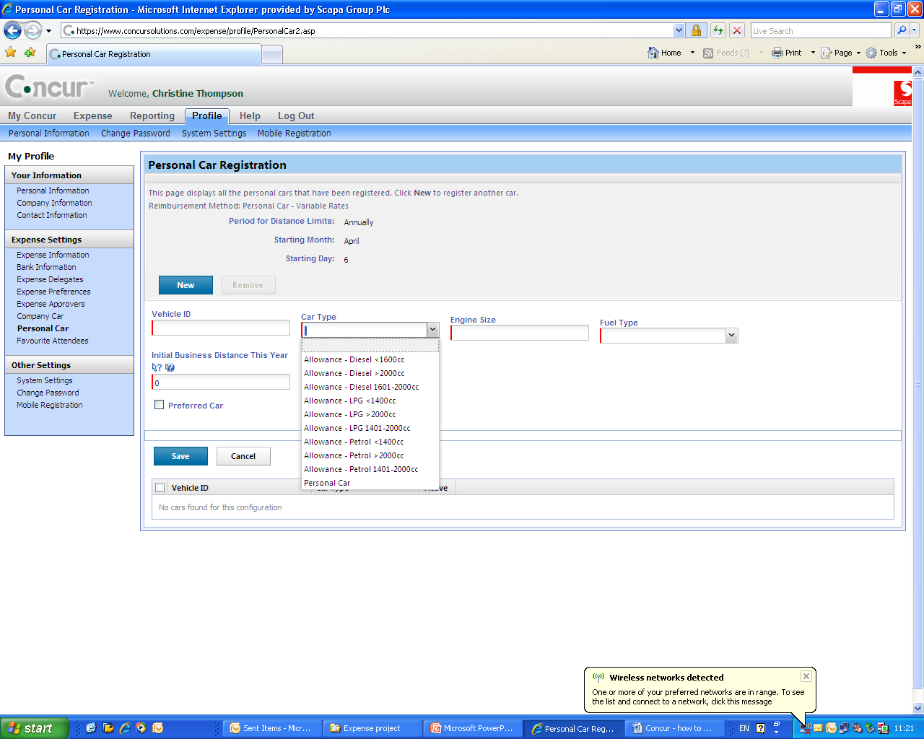
Car information
World Class Tape Solutions

Slide 9
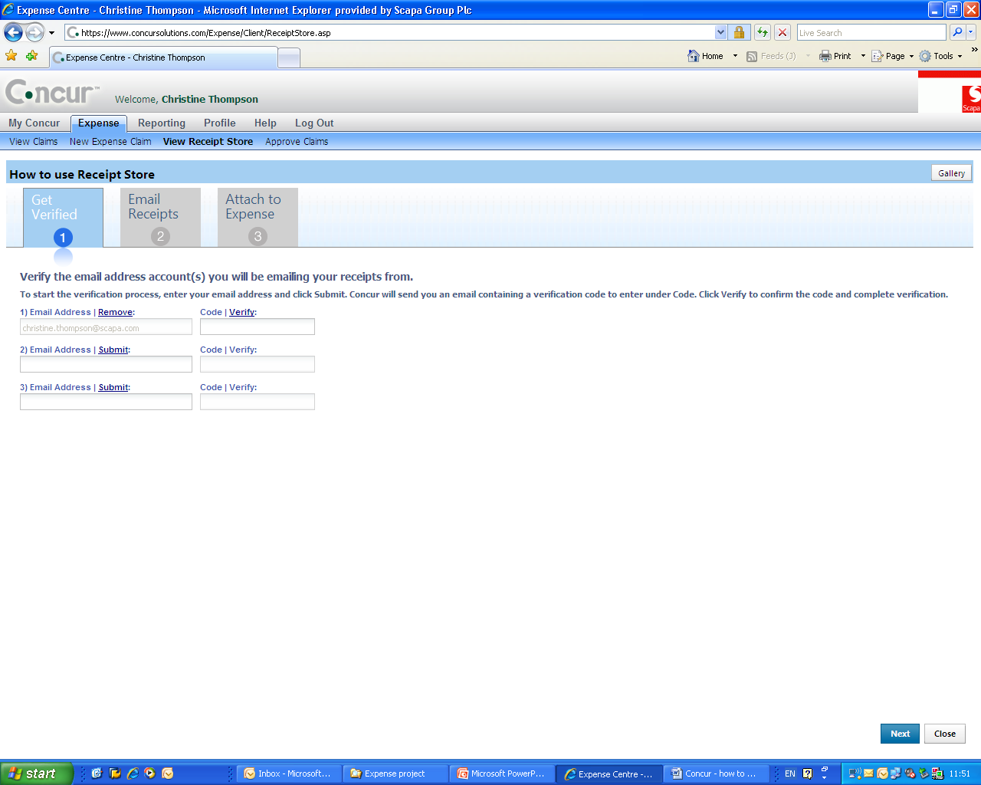
Set up receipt store
World Class Tape Solutions

Slide 10
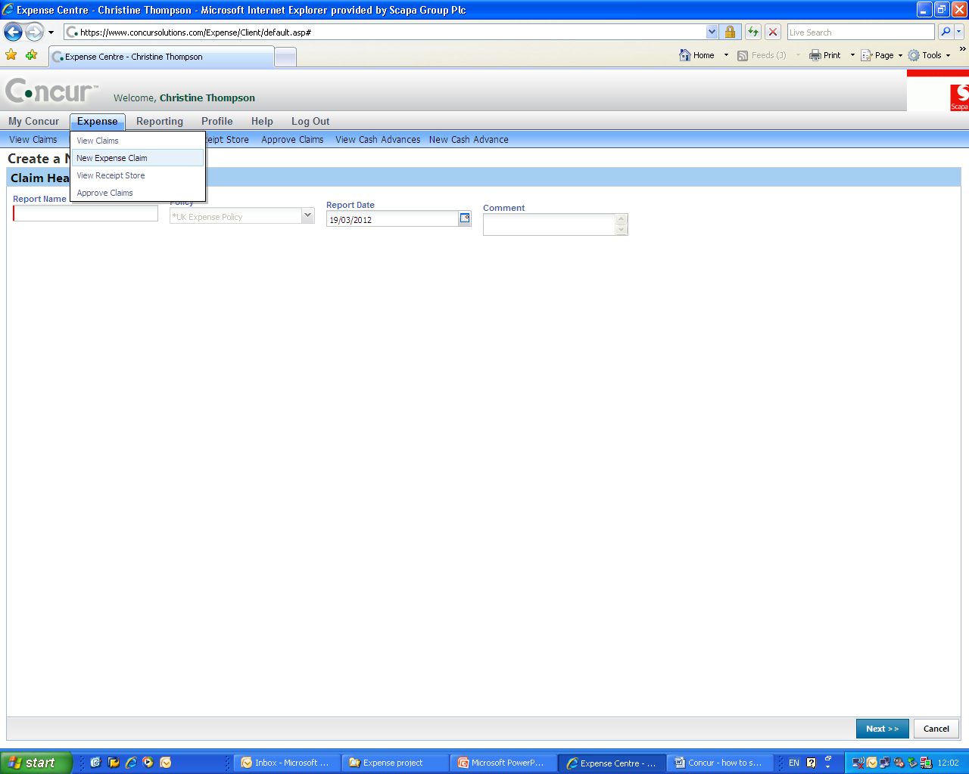
Submit expense claim
World Class Tape Solutions

Slide 11
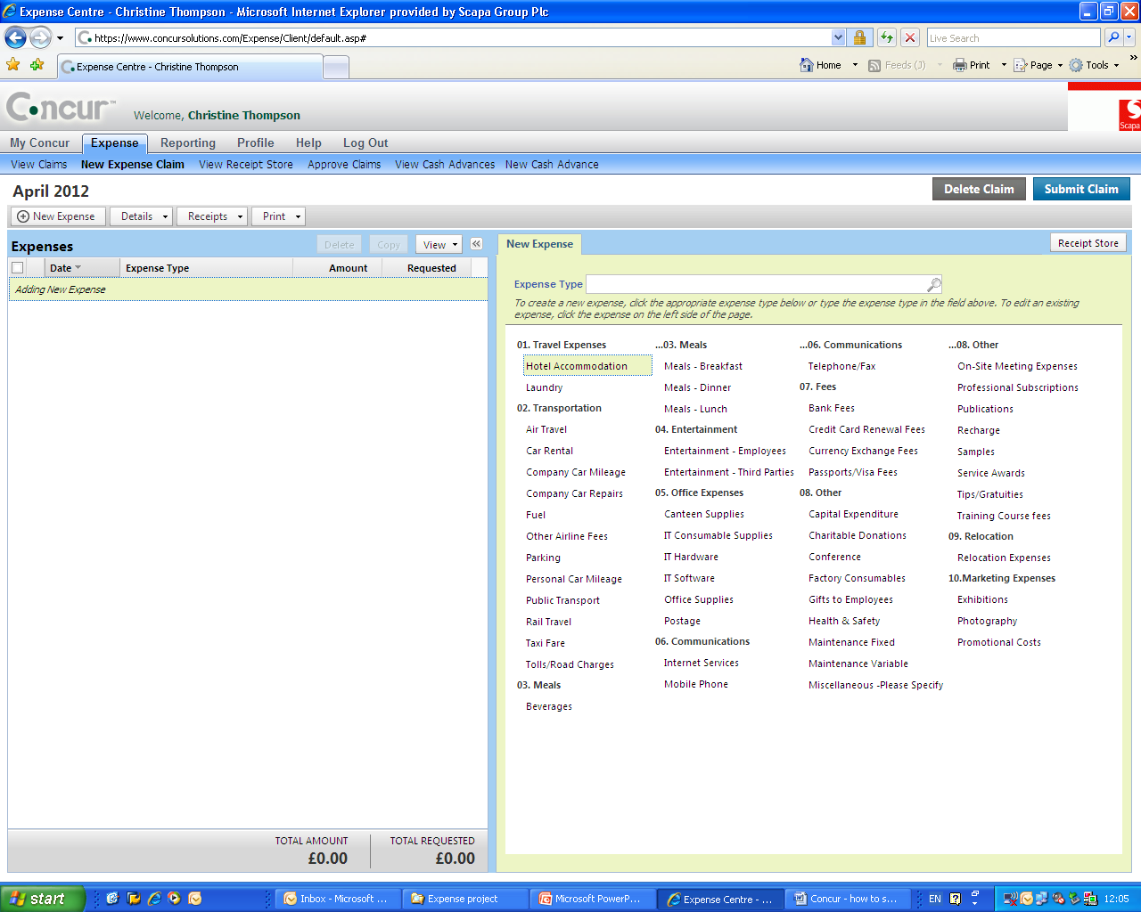
Submit expense claim
World Class Tape Solutions

Slide 12
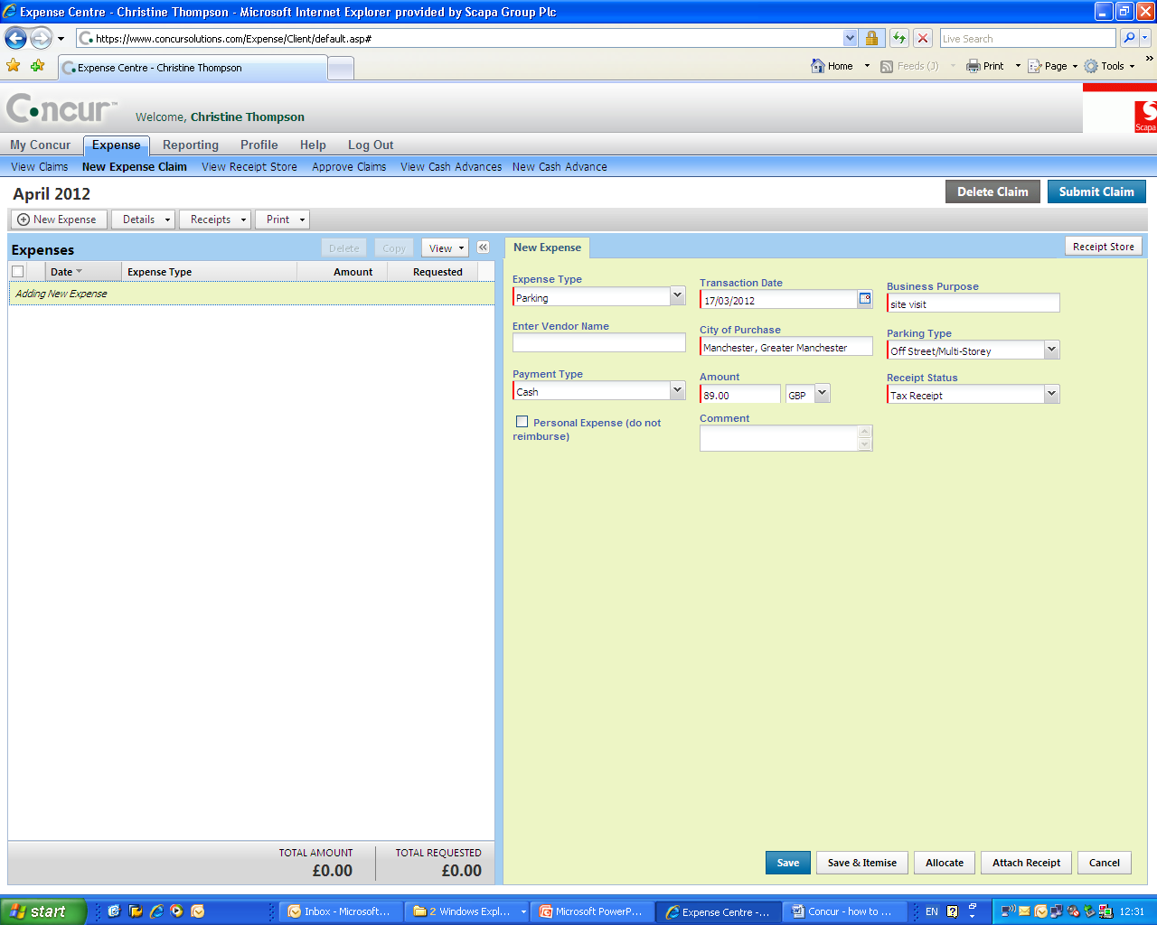
Submit expense claim
World Class Tape Solutions

Slide 13
Expense types - more information
Hotel accommodation
Meals
Car mileage
Credit card/mobile app
World Class Tape Solutions

Slide 14
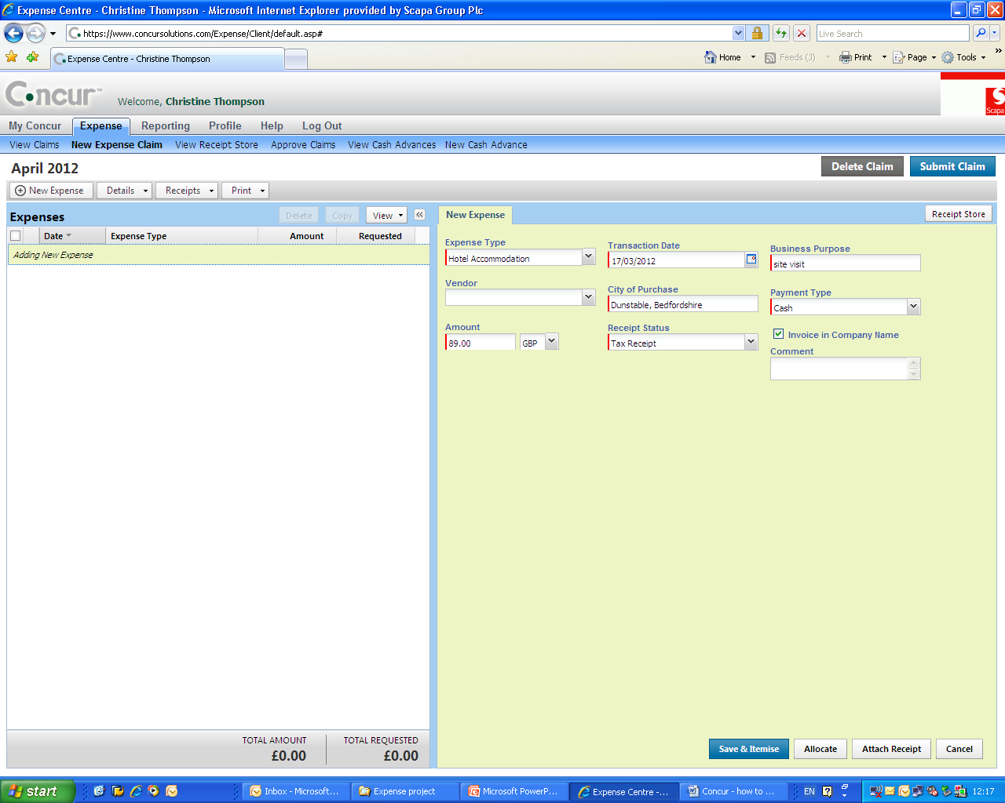
Submit expense claim - Hotels
World Class Tape Solutions

Slide 15
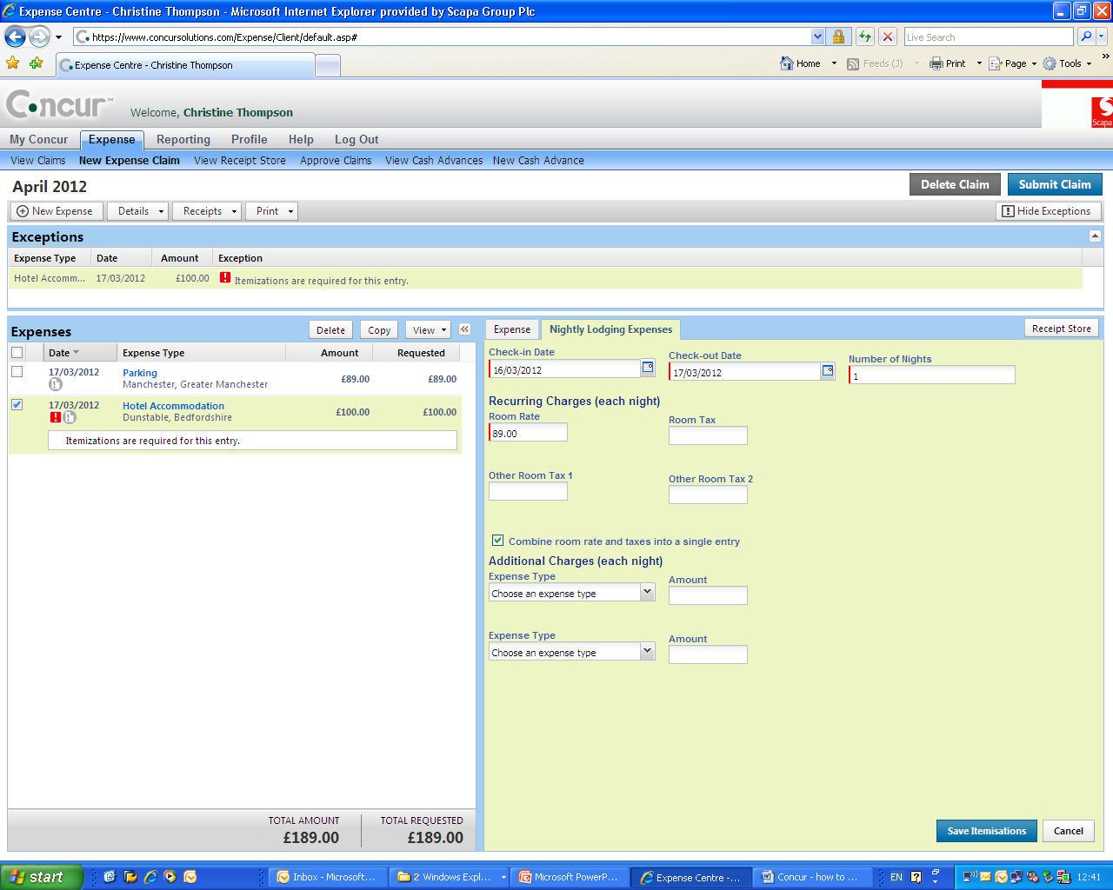
Submit expense claim - Hotels
World Class Tape Solutions

Slide 16
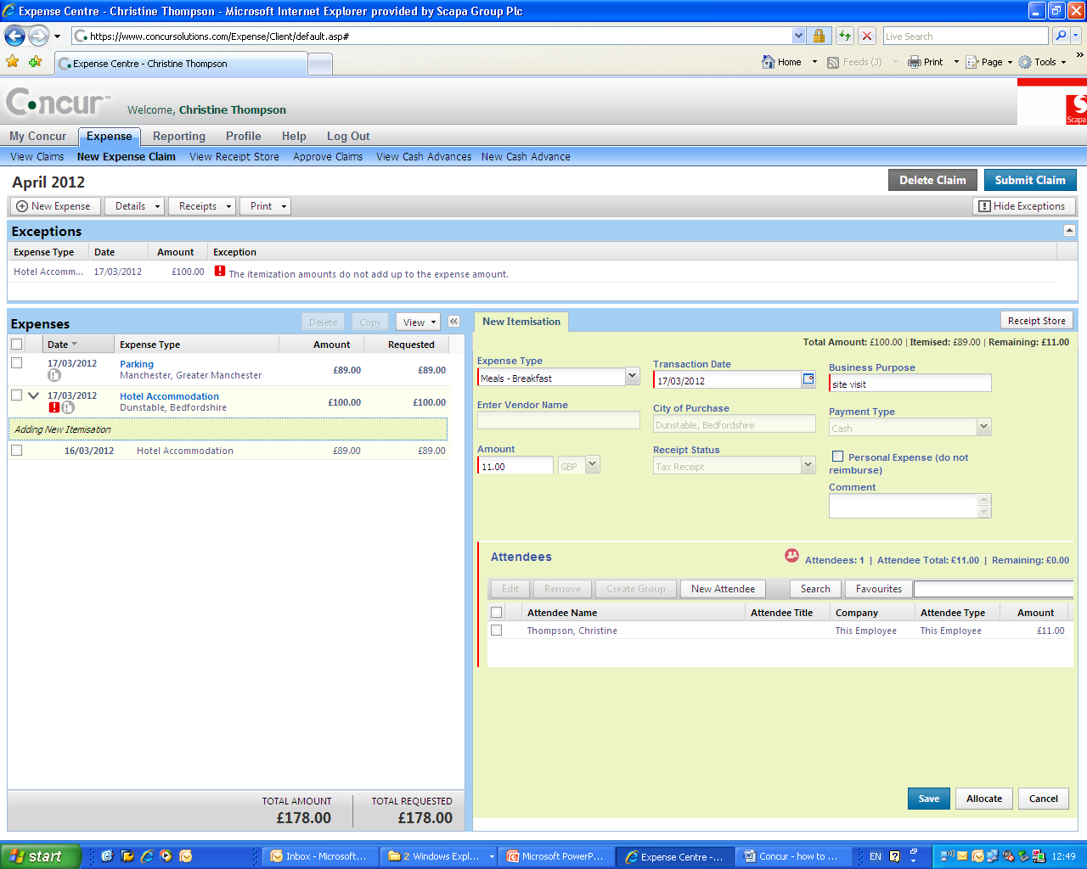
Submit expense claim - Meals
World Class Tape Solutions

Slide 17
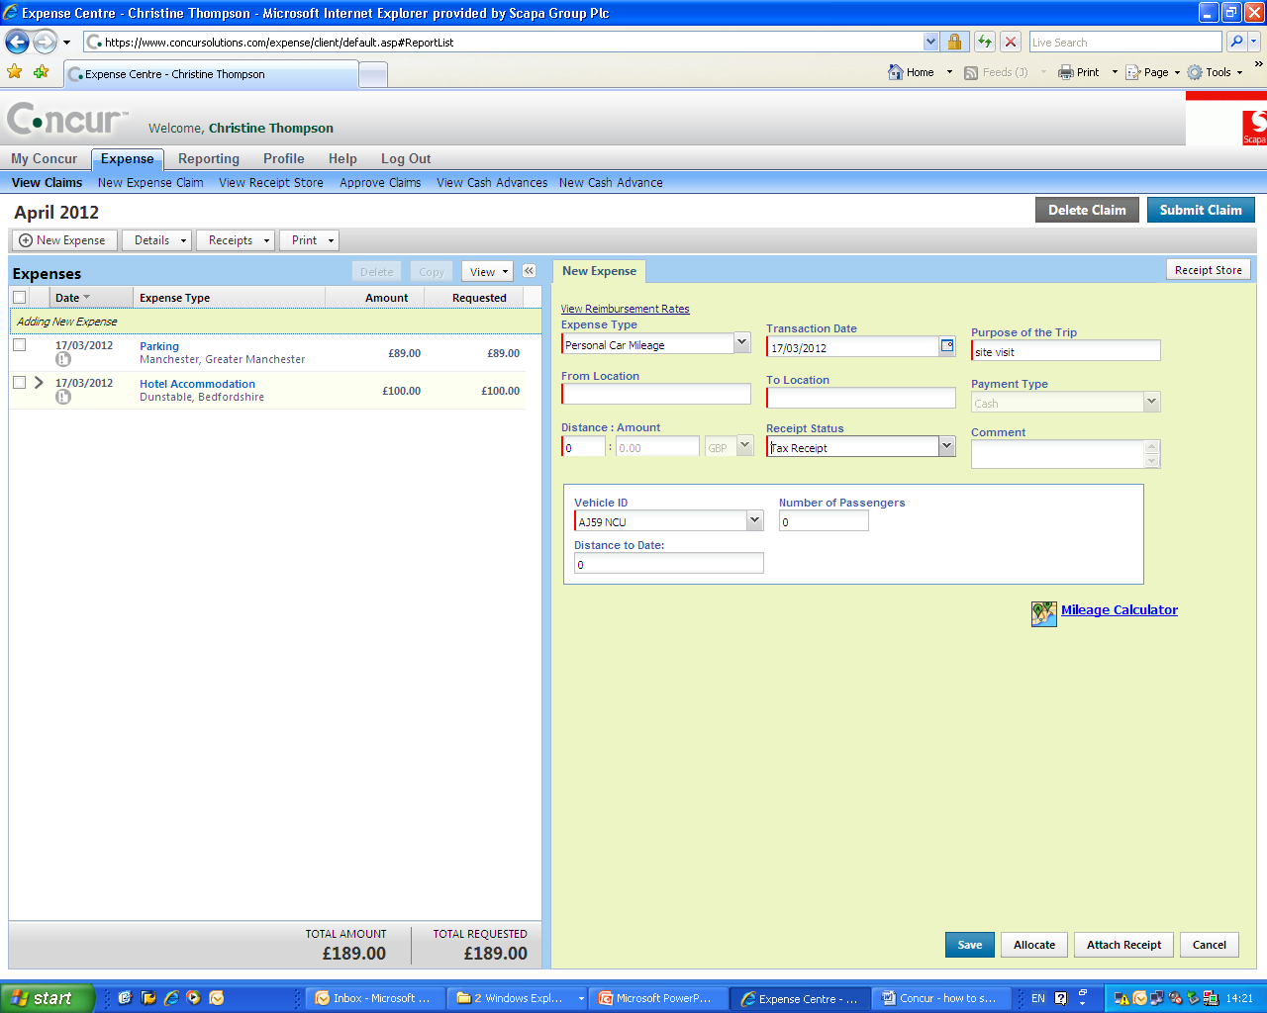
Submit expense claim - Mileage
World Class Tape Solutions

Slide 18
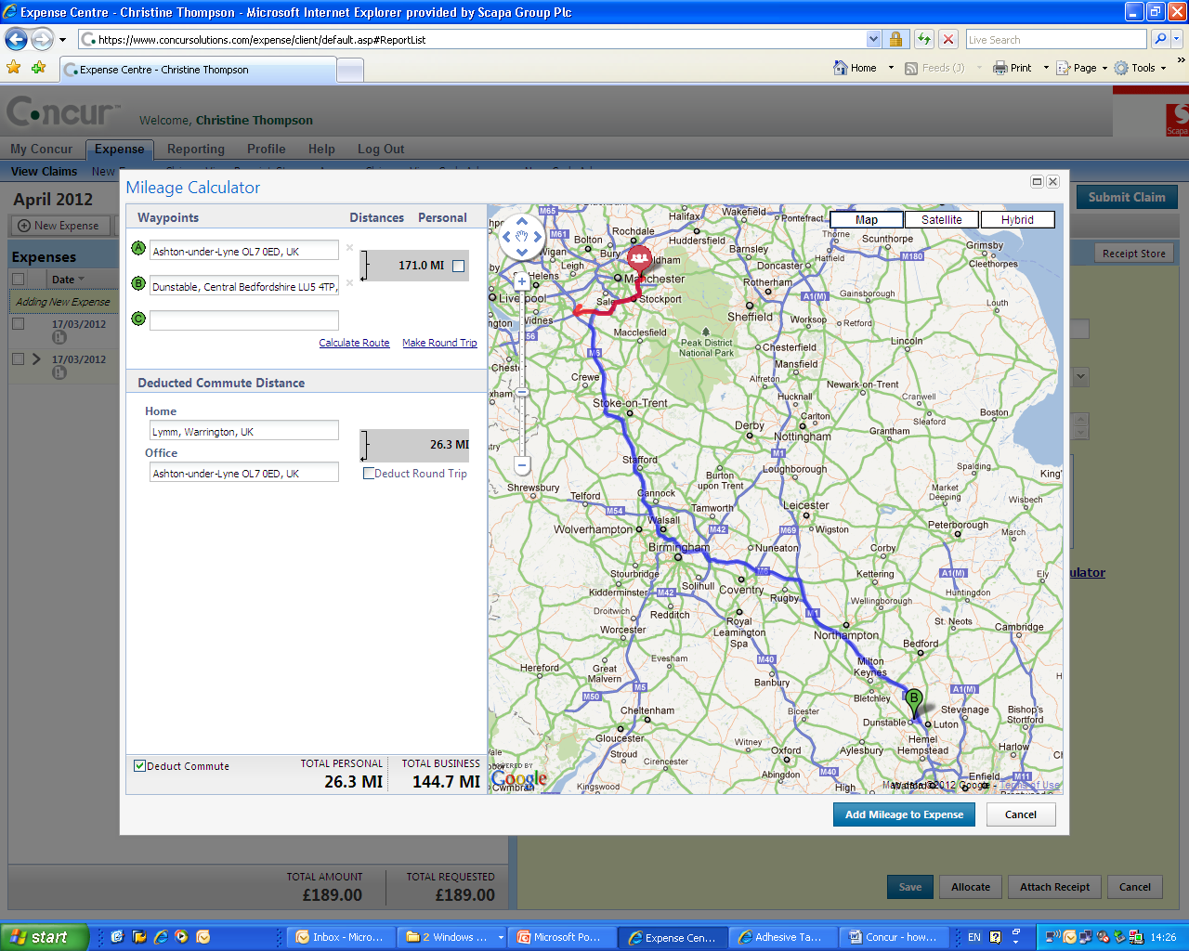
Submit expense claim - Mileage
World Class Tape Solutions

Slide 19
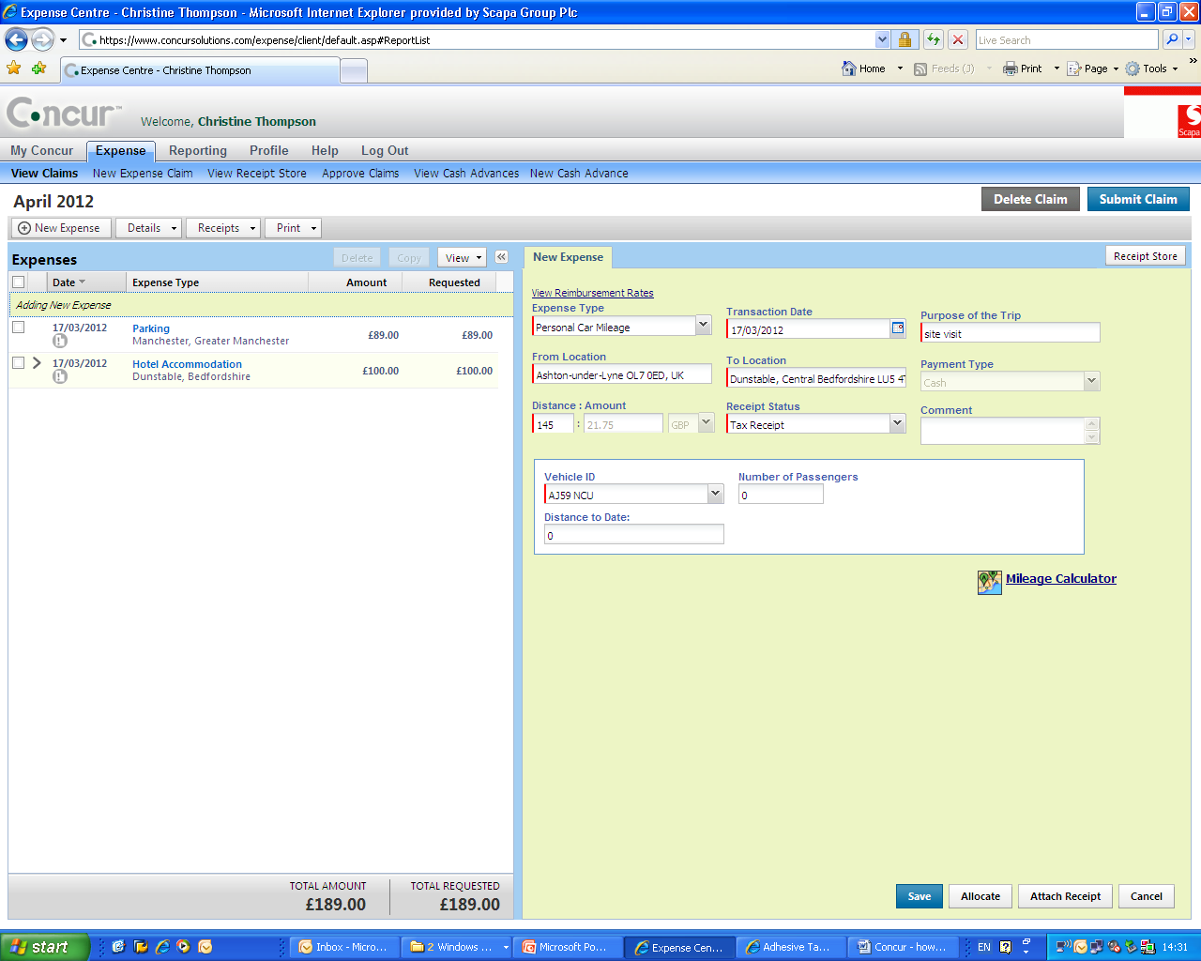
Submit expense claim - Mileage
World Class Tape Solutions

Slide 20
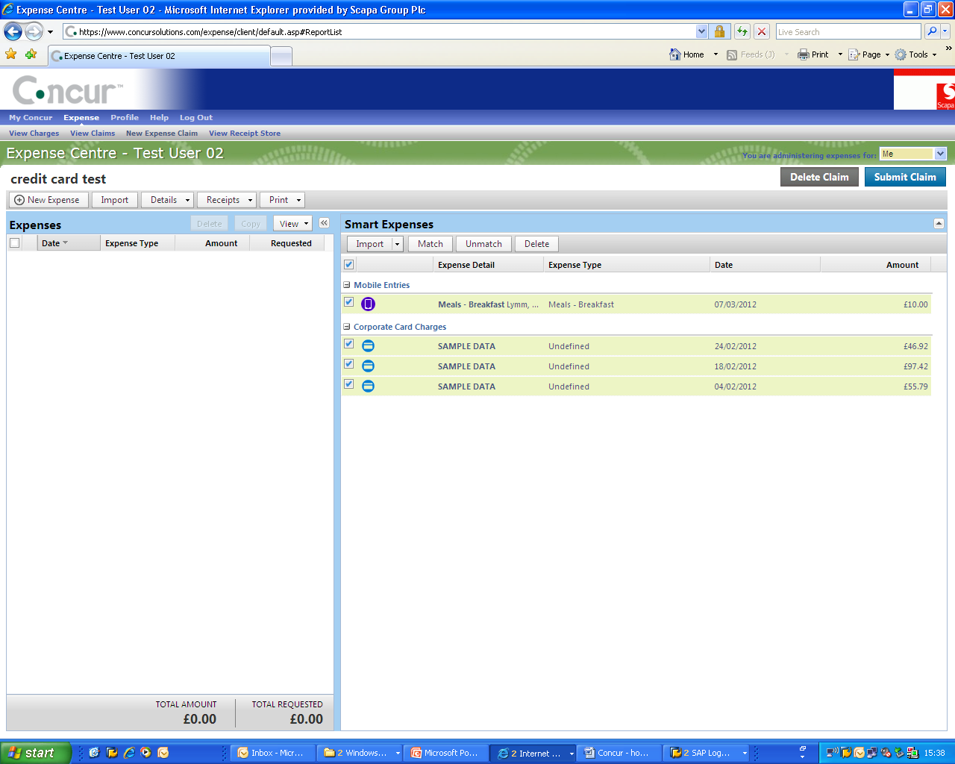
Credit card/mobile device entry
World Class Tape Solutions

Slide 21
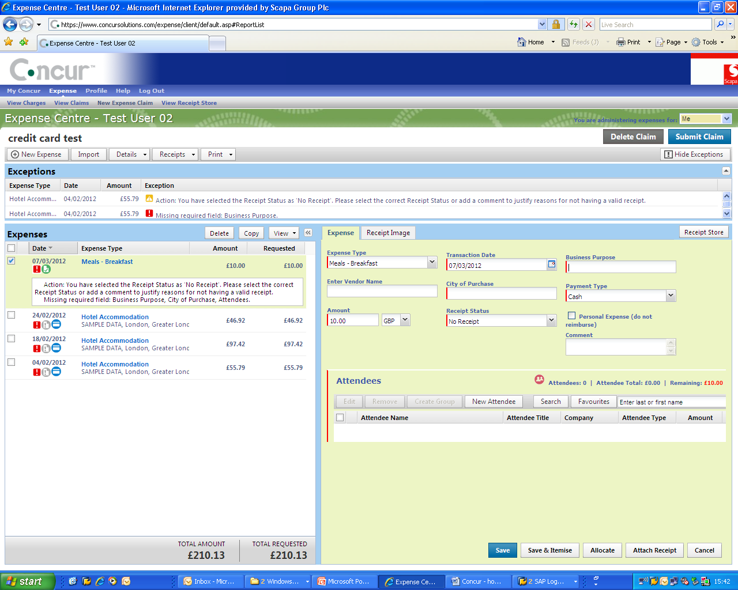
Credit card/mobile device entry
World Class Tape Solutions

Slide 22
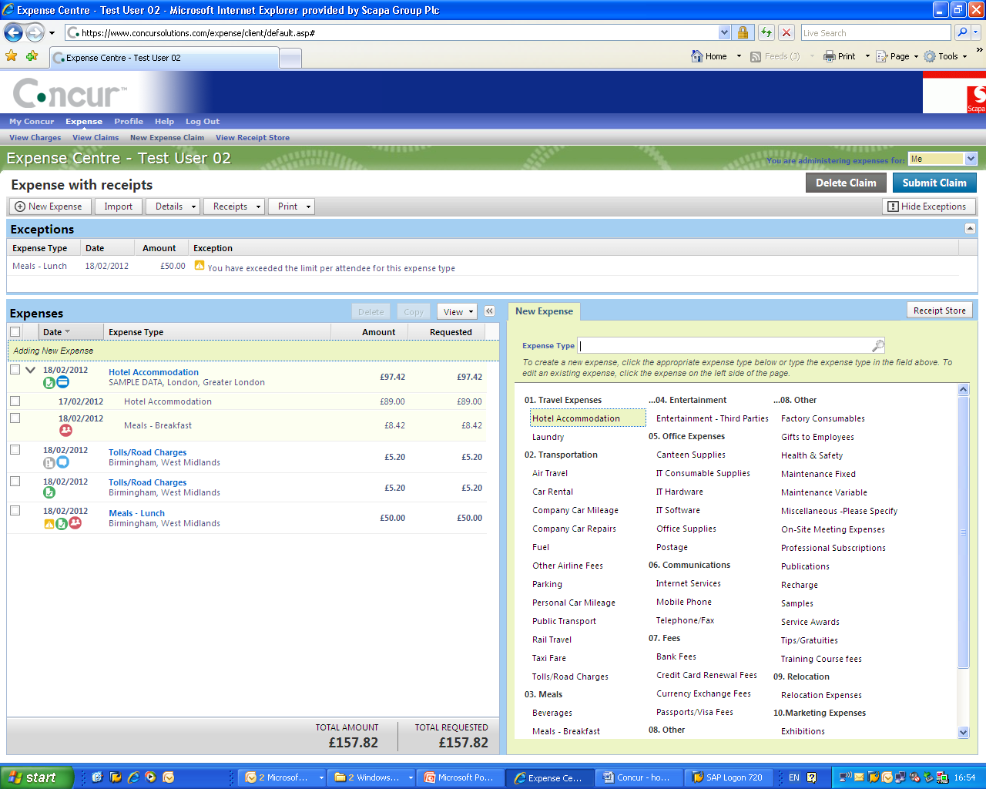
Expense claim ready to submit
World Class Tape Solutions

Slide 23
What happens next?
Could be selected for audit
First signatory
Second signatory
Administration
Sent for payment
World Class Tape Solutions

Slide 24
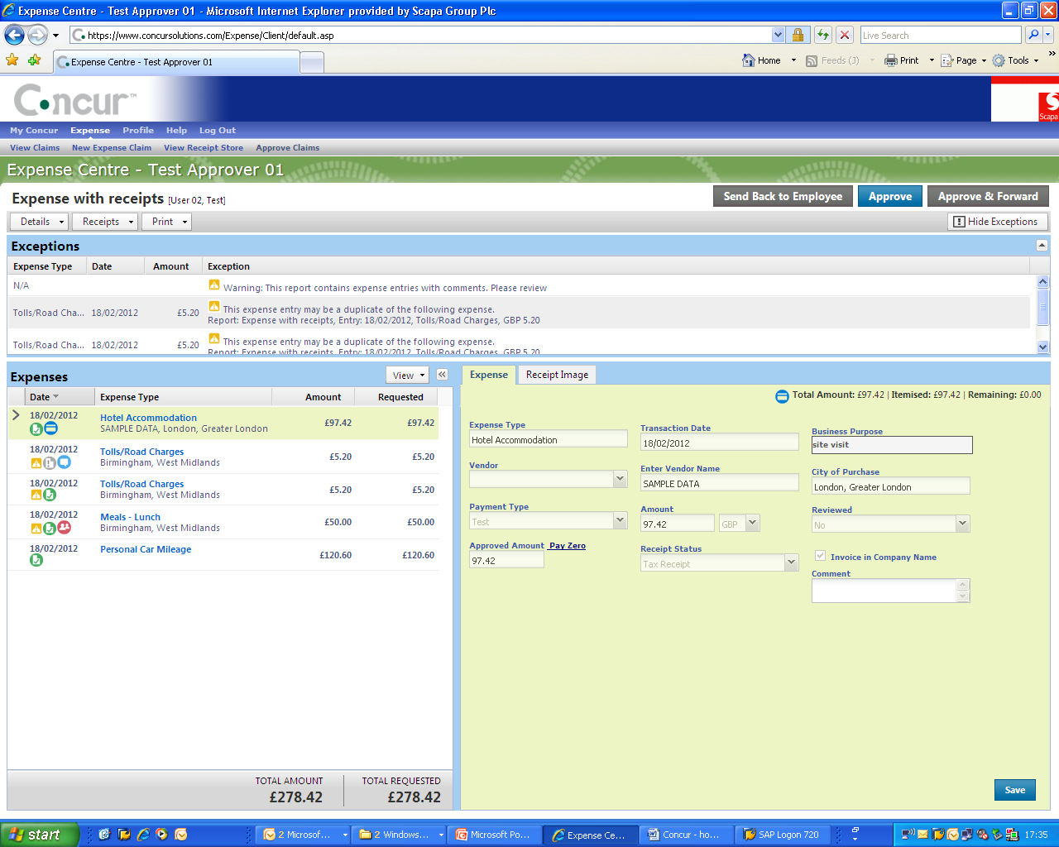
Authorise an expense claim
World Class Tape Solutions

Slide 25
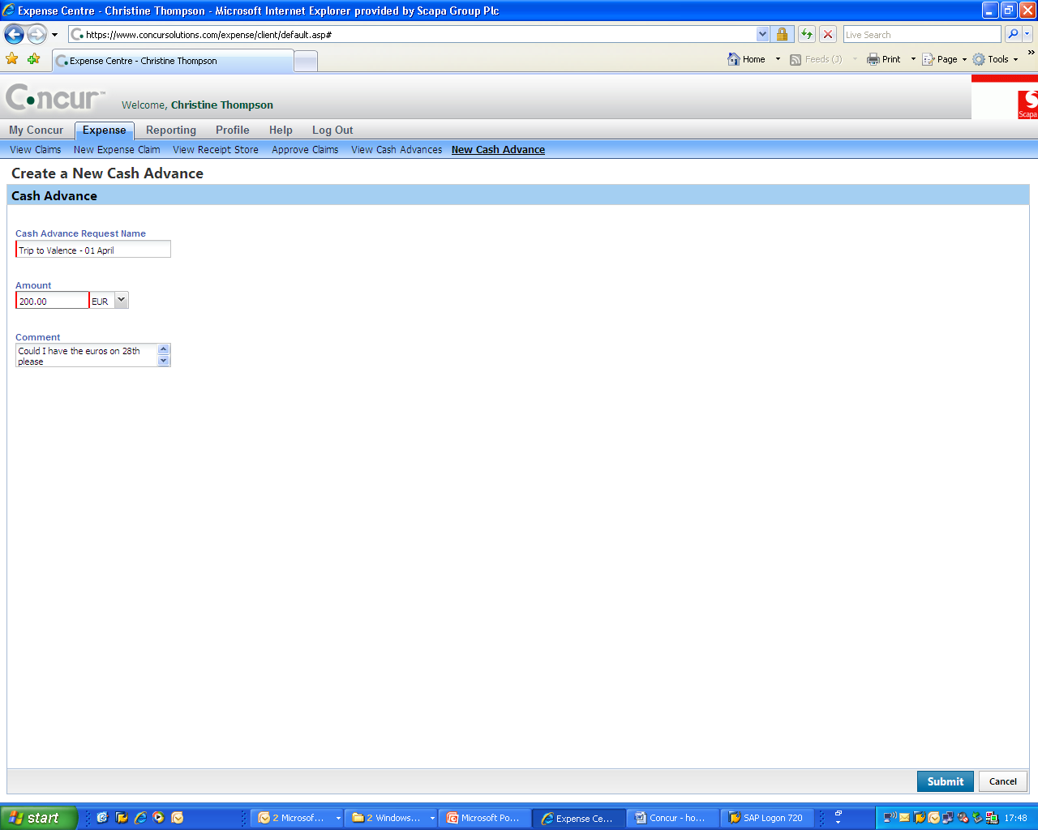
Request a cash advance
World Class Tape Solutions

Slide 26
Receipts
Ensure choose correct receipt type
Per line - One receipt image per expense line
Tax receipts – where available
Fuel receipts – If a receipt covers more than one trip still select tax receipt
Paper receipts – send to Ashton in an envelope
World Class Tape Solutions

Slide 27
If you need assistance
Please contact:
Helen Dawson
Christine Thompson
World Class Tape Solutions

